Slide 1

Decision-Making Statements
Decision-making statements in C++ are similar to real-life decision-making, where an action is taken based on certain conditions.
For example:
if it's raining outside then we need to carry an umbrella. In programming also, we have some situations when we need a specific code to be executed only when a condition is satisfied.
The decision control statements help us in this task by evaluating a boolean expression and accordingly controlling the flow of the program.
www.opentechz.com

Slide 2
Decision-Making Statements
C++ provides five main types of decision-making statements:
if Statement
if-else Statement
Nested if-else Statement
if-else-if Ladder
5. switch
www.opentechz.com

Slide 3
Decision-Making Statements
if Statement
These are the simplest and most widely used control statements in C++.
The if statement is used to decide whether a particular block of code will be executed or not, based on a given condition.
If the condition is true, the block is executed.
If the condition is false, the block is skipped.
Syntax :
If ( condition ){
//logic
}
www.opentechz.com

Slide 4
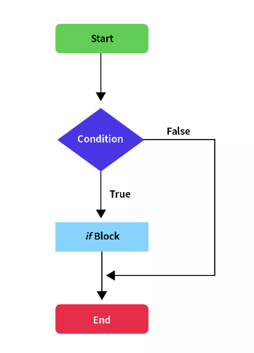
Decision-Making Statements

Slide 5
Examples :
#include <iostream>
using namespace std;
int main() {
int age = 20;
if (age >= 18) {
cout << "You are eligible to vote." << endl;
}
return 0;
}
#include <iostream>
using namespace std;
int main() {
int temperature = 35;
if (temperature > 30) {
cout << "It's a hot day." << endl;
}
return 0;
}

Slide 6
Decision-Making Statements
2. if-else Statement
The if-else statement is used to execute one block of code if the condition is true, and another block if the condition is false.
Syntax :
If ( condition ){
//logic
}
else{
//logic
}

Slide 7
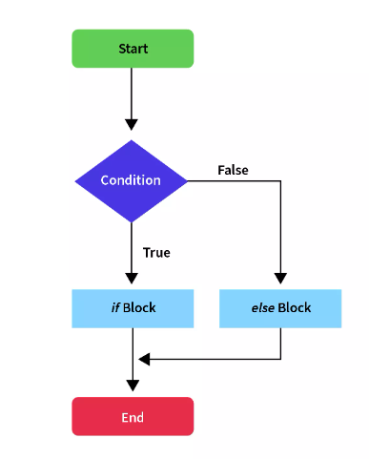
Decision-Making Statements

Slide 8
Examples :
#include <iostream>
using namespace std;
int main() {
int number = 5;
if (number % 2 == 0) {
cout << "Even number" << endl;
} else {
cout << "Odd number" << endl;
}
return 0;
}
#include <iostream>
using namespace std;
int main() {
int marks = 45;
if (marks >= 50) {
cout << "Pass" << endl;
} else {
cout << "Fail" << endl;
}
return 0;
}

Slide 9
Decision-Making Statements
3. Nested if-else Statement
When one if or else block contains another if-else statement, it is called a nested if-else.
Used for checking multiple related conditions step by step.
Syntax :
If ( condition ){
If ( condition ){
//logic
}
else{
//logic
}
}
else{
//logic
}

Slide 10
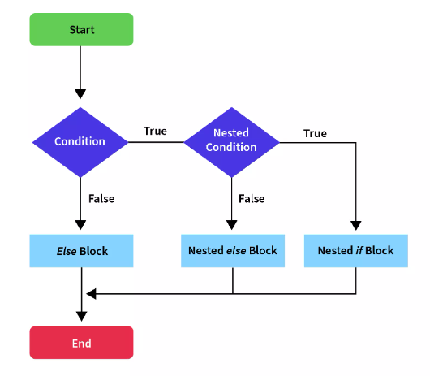
Decision-Making Statements

Slide 11
Examples :
#include <iostream>
using namespace std;
int main() {
int marks = 85;
if (marks >= 40) {
if (marks >= 75) {
cout << "Distinction" << endl;
} else {
cout << "Pass" << endl;
}
} else {
cout << "Fail" << endl;
}
return 0;
}
#include <iostream>
using namespace std;
int main() {
int age = 25;
char gender = 'F';
if (age > 18) {
if (gender == 'M') {
cout << "Adult Male" << endl;
} else {
cout << "Adult Female" << endl;
}
} else {
cout << "Minor" << endl;
}
return 0;
}

Slide 12

Thank You
www.opentechz.com

